Slide 1


Noida Institute of Engineering and Technology, Greater Noida
KCS 501
Database Management System
Unit: 5
Concurrency Control Techniques
Ram Kumar Sharma
Assistant Prof. IT Deptt.
NIET Gr Noida
B.Tech. (IT) 5th Sem

Slide 2
Content
Syllabus of Unit 5
Course Objective of Unit 5
Course Outcomes of Unit 5
CO-PO Mapping
CO- PSO Mapping
Prerequisite and Recap
Concurrency Control
Concurrency Control Techniques
Lock-Based Protocols
The Two-Phase Locking Protocol
Lock Conversions
Pitfalls of Lock-Based Protocols
Graph-Based Protocols
Tree Protocol

Slide 3
Content
Timestamp-Based Protocols
Thomas’ Write Rule
Validation Based Protocol
Multiple Granularity
Intention Lock Modes
Compatibility Matrix with Intention Lock Modes
Multiple Granularity Locking Scheme
Faculty Video Links, Youtube & NPTEL Video Links and Online Courses Details
MCQ
Weekly Assignment 5.1
Old Question Papers
Expected Questions for University Exam
References

Slide 4
Syllabus of Unit 5
Concurrency Control Techniques: Concurrency Control, Locking Techniques for Concurrency Control, Time Stamping Protocols for Concurrency Control, Validation Based Protocol, Multiple Granularity, Multi Version Schemes, Recovery with Concurrent Transaction, Case Study of Oracle.

Slide 5
Course Objective of Unit 5
Knowledge of executing multiple transaction in concurrent fashion.
Explain basic issues of transaction processing and concurrency control.
Study the various concurrency control techniques

Slide 6
Course Outcomes of Unit 5
At the end of semester students will be able
CO5 | To apply dbms concepts in software development applications for the community and society. Software development needs to be developed in a team for better understanding of human problem. Transaction properties enforce the database consistency and recovery is needed at the time of database failure.

Slide 7
CO-PO Mapping
co-po correlation matrix
co.k | po1 | po2 | po3 | po4 | po5 | po6 | po7 | po8 | po9 | po10 | po11 | po12
KCS-501.5 | 2 | 3 | 2 | 2 | 2 | 2 | 2 | 2 | 3 | 2 | 2 | 2

Slide 8
CO-PSO Mapping
co.k | pso1 | pso2 | pso3 | pso4
KCS-501.5 | 2 | 2 | 3 | 2

Slide 9
Prerequisite and Recap
Knowledge of Transaction
Scheduling & Serializability
Knowledge of RDBMS concepts

Slide 10
Content unit 5 (Lecture 31 to 40)
Concurrency Control
Concurrency Control Techniques
Lock-Based Protocols
The Two-Phase Locking Protocol
Lock Conversions
Pitfalls of Lock-Based Protocols
Graph-Based Protocols
Tree Protocol
Timestamp-Based Protocols
Thomas’ Write Rule
Validation Based Protocol
Multiple Granularity
Intention Lock Modes
Compatibility Matrix with Intention Lock Modes
Multiple Granularity Locking Scheme

Slide 11
Topic mapping with CO
Topic | CO
Concurrency Control Concurrency Control Techniques Lock-Based Protocols The Two-Phase Locking Protocol Lock Conversions Pitfalls of Lock-Based Protocols | CO5
Graph-Based Protocols Tree Protocol | CO5
Timestamp-Based Protocols Thomas’ Write Rule Validation Based Protocol | CO5
Multiple Granularity Intention Lock Modes Compatibility Matrix with Intention Lock Modes Multiple Granularity Locking Scheme | CO5

Slide 12
Topic Objectives
Topic | Objectives
Concurrency Control Concurrency Control Techniques Lock-Based Protocols The Two-Phase Locking Protocol Lock Conversions Pitfalls of Lock-Based Protocols | Students will be able to learn how number of transactions are processing simultaneously
Graph-Based Protocols Tree Protocol | Students will be able to understand the methods to control concurrency by using graphs
Timestamp-Based Protocols Thomas’ Write Rule Validation Based Protocol | Students will be able to find the other solutions for concurrency control
Multiple Granularity Intention Lock Modes Compatibility Matrix with Intention Lock Modes Multiple Granularity Locking Scheme | Students will be able to learn the high level techniques to control execution of multiple transactions

Slide 13
Concurrency Control (CO5)
A database must provide a mechanism that will ensure that all possible schedules are
either conflict or view serializable, and
are recoverable and preferably cascadeless
A policy in which only one transaction can execute at a time generates serial schedules, but provides a poor degree of concurrency
Are serial schedules recoverable/cascadeless?
Testing a schedule for serializability after it has executed is a little too late!
Goal – to develop concurrency control protocols that will assure serializability.

Slide 14
Concurrency Control Techniques (CO5)
Concurrency Control
it is process of managing simultaneous execution of transaction in a shared database to ensure the serializability of transaction.
Purpose of Concurrency Control
To enforce Isolation
To preserve database consistency
To resolve the read write or write – write conflicts.

Slide 15
Lock-Based Protocols (CO5)
A lock is a mechanism to control concurrent access to a data item
To access data item lock is acquired
After completion of transaction lock must be released
Data items can be locked in two modes :
1. exclusive (X) mode. Data item can be both read as well as write. X-lock is requested using lock-X instruction.
2. shared (S) mode. Data item can only be read. S-lock is
requested using lock-S instruction.
Lock requests are made to concurrency-control manager. Transaction can proceed only after request is granted.

Slide 16
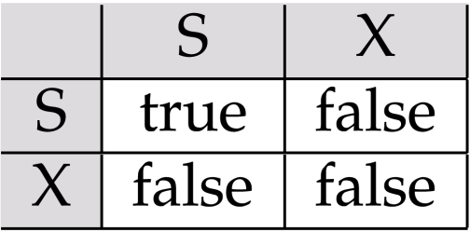
Lock-Based Protocols (CO5) contd
A locking protocol is a set of rules followed by all transactions while requesting and releasing locks. Locking protocols restrict the set of possible schedules.
Lock-compatibility matrix
A transaction may be granted a lock on an item if the requested lock is compatible with locks already held on the item by other transactions
Any number of transactions can hold shared locks on an item,
but if any transaction holds an exclusive on the item no other transaction may hold any lock on the item.
If a lock cannot be granted, the requesting transaction is made to wait till all incompatible locks held by other transactions have been released. The lock is then granted.

Slide 17
Lock-Based Protocols (CO5)
Example of a transaction performing locking:
T₂: lock-S(A);
read (A);
unlock(A);
lock-S(B);
read (B);
unlock(B);
display(A+B)
Locking as above is not sufficient to guarantee serializability
if A and B get updated in-between the read of A and B, the displayed sum would be wrong.

Slide 18
The Two-Phase Locking Protocol
This is a protocol which ensures conflict-serializable schedules.
Phase 1: Growing Phase
transaction may obtain locks
transaction may not release locks
Phase 2: Shrinking Phase
transaction may release locks
transaction may not obtain locks
The protocol assures serializability. It can be proved that the transactions can be serialized in the order of their lock points (i.e. the point where a transaction acquired its final lock).

Slide 19
The Two-Phase Locking Protocol (Cont.)
Two-phase locking does not ensure freedom from deadlocks
Cascading roll-back is possible under two-phase locking. To avoid this, follow a modified protocol called strict two-phase locking. Here a transaction must hold all its exclusive locks till it commits/aborts.
Rigorous two-phase locking is even stricter: here all locks are held till commit/abort. In this protocol transactions can be serialized in the order in which they commit.

Slide 20
The Two-Phase Locking Protocol (Cont.)
There can be conflict serializable schedules that cannot be obtained if two-phase locking is used.
However, in the absence of extra information (e.g., ordering of access to data), two-phase locking is needed for conflict serializability in the following sense:
Given a transaction T_{i} that does not follow two-phase locking, we can find a transaction T_{j} that uses two-phase locking, and a schedule for T_{i} and T_{j} that is not conflict serializable.

Slide 21
Lock Conversions (CO5)
Two-phase locking with lock conversions:
– First Phase:
can acquire a lock-S on item
can acquire a lock-X on item
can convert a lock-S to a lock-X (upgrade)
– Second Phase:
can release a lock-S
can release a lock-X
can convert a lock-X to a lock-S (downgrade)
This protocol assures serializability. But still relies on the programmer to insert the various locking instructions.

Slide 22
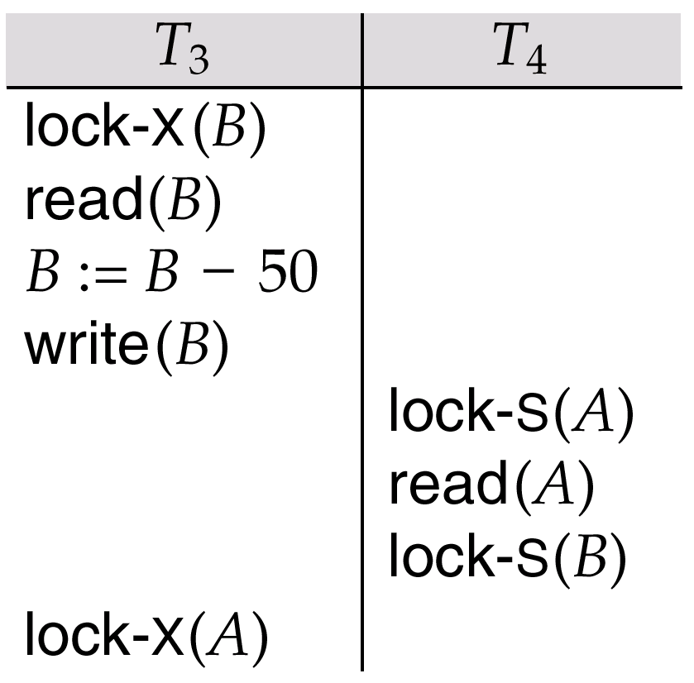
Pitfalls of Lock-Based Protocols
Consider the partial schedule
Neither T₃ nor T₄ can make progress — executing lock-S(B) causes T₄ to wait for T₃ to release its lock on B, while executing lock-X(A) causes T₃ to wait for T₄ to release its lock on A.
Such a situation is called a deadlock.
To handle a deadlock one of T₃ or T₄ must be rolled back and its locks released.

Slide 23
Pitfalls of Lock-Based Protocols
The potential for deadlock exists in most locking protocols. Deadlocks are a necessary evil.
Starvation is also possible if concurrency control manager is badly designed. For example:
A transaction may be waiting for an X-lock on an item, while a sequence of other transactions request and are granted an S-lock on the same item.
The same transaction is repeatedly rolled back due to deadlocks.
Concurrency control manager can be designed to prevent starvation.

Slide 24
The Two-Phase Locking Protocol (Cont.)
Problems with 2-PL,
Cascading Aborts and Deadlocks.
There are three categories:
Strict 2-PL
Rigorous 2-PL
Conservative 2-PL

Slide 25
The Two-Phase Locking Protocol (Cont.)
Strict-2PL
The first phase of Strict-2PL is same as 2PL.
After acquiring all the locks in the first phase, the transaction continues to execute normally. But in contrast to 2PL, Strict-2PL does not release a lock after using it.
Strict-2PL holds all the locks until the commit point and releases all the locks at a time.
Strict-2PL does not have cascading abort as 2PL does.
Following Strict 2-PL ensures that our schedule is:
Recoverable
Cascadeless

Slide 26
The Two-Phase Locking Protocol (Cont.)
Rigorous 2-PL –
This requires that in addition to the lock being 2-Phase all Exclusive(X) and Shared(S) Locks held by the transaction be released until after the Transaction Commits.
Following Rigorous 2-PL ensures that our schedule is:
Recoverable
Cascadeless

Slide 27
The Two-Phase Locking Protocol (Cont.)
Conservative 2-PL –
Static 2-PL, this protocol requires the transaction to lock all the items it access before the Transaction begins execution by predeclaring its read-set and write-set.
If any of the predeclared items needed cannot be locked, the transaction does not lock any of the items, instead it waits until all the items are available for locking. Conservative 2-PL is Deadlock free and but it does not ensure Strict schedule

Slide 28
Graph-Based Protocols
Graph-based protocols are an alternative to two-phase locking
Impose a partial ordering → on the set D = {d₁, d₂ ,..., d_{h}} of all data items.
If d_{i} → d_{j} then any transaction accessing both d_{i} and d_{j} must access d_{i} before accessing d_{j}.
Implies that the set D may now be viewed as a directed acyclic graph, called a database graph.
The tree-protocol is a simple kind of graph protocol.

Slide 29
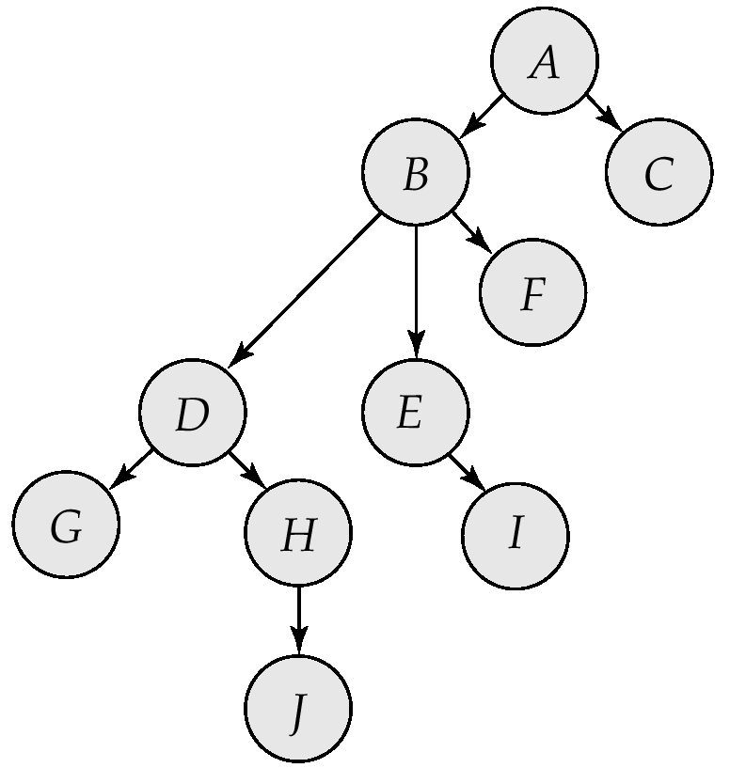
Tree Protocol (CO 5)
Only exclusive locks are allowed.
The first lock by T_{i} may be on any data item. Subsequently, a data Q can be locked by T_{i} only if the parent of Q is currently locked by T_{i}.
Data items may be unlocked at any time.
A data item that has been locked and unlocked by T_{i} cannot subsequently be relocked by T_{i}

Slide 30
Tree Protocol (CO 5)
Advantage –
Ensures Conflict Serializable Schedule.
Ensures Deadlock Free Schedule
Unlocking can be done anytime
Disadvantage –
Unnecessary locking overheads may happen sometimes, like if we want both D and E, then at least we have to lock B to follow the protocol.
Cascading Rollbacks is still a problem. We don’t follow a rule of when Unlock operation may occur so this problem persists for this protocol.

Slide 31
Tree Protocol (CO 5)
 | T1 | T2 | T3
1 | Lock-X(A)
2 | Lock-X(B)
3 |  | Lock-X(D)
4 |  | Lock-X(H)
5 |  | Unlock-X(D)
6 | Lock-X(E)
7 | Lock-X(D)
8 | Unlock-X(B)
9 | Unlock-X(E)
10 |  |  | Lock-X(B)
11 |  |  | Lock-X(E)
12 |  | Unlock-X(H)
13 | Lock-X(B)
14 | Lock-X(G)
15 | Unlock-X(D)
16 |  |  | Unlock-X(E)
17 |  |  | Unlock-X(B)
18 | Unlock-X(G)

Slide 32
Tree Protocol (CO 5)
 | T1 | T2 | T3 | T4
1 | Lock- X(B)
2 |  | Lock-X(D)
3 |  | Lock-X(H)
4 |  | Unlock (D)
5 | Lock-X(E)
6 | lock-X(D)
7 | unLock-X(E)
8 | unlock-X(B)
9 |  |  | Lock-X(B)
10 |  |  | lock-X(E)
11 |  | Unlock(H)
12 | Lock-X(G)
13 | Unlock(D)
14 |  |  |  | Lock-X(D)
15 |  |  |  | Lock-X(H)
16 |  |  |  | Unlock (D)
17 |  |  |  | Unlock(H)
18 |  |  | Unlock(E)
19 |  |  | Unlock(B)
20 | Unlock (G)

Slide 33
Timestamp-Based Protocols
Each transaction is issued a timestamp when it enters the system. If an old transaction T_{i} has time-stamp TS(T_{i}), a new transaction T_{j} is assigned time-stamp TS(T_{j}) such that TS(T_{i}) <TS(T_{j}).
The protocol manages concurrent execution such that the time-stamps determine the serializability order.
In order to assure such behavior, the protocol maintains for each data Q two timestamp values:
W-timestamp(Q) is the largest time-stamp of any transaction that executed write(Q) successfully.
R-timestamp(Q) is the largest time-stamp of any transaction that executed read(Q) successfully.

Slide 34
Timestamp-Based Protocols (Cont.)
The timestamp ordering protocol ensures that any conflicting read and write operations are executed in timestamp order.
Suppose a transaction T_{i} issues a read(Q)
If TS(T_{i}) ≤ W-timestamp(Q), then T_{i} needs to read a value of Q that was already overwritten.
Hence, the read operation is rejected, and T_{i} is rolled back.
If TS(T_{i}) ≥ W-timestamp(Q), then the read operation is executed, and R-timestamp(Q) is set to max(R-timestamp(Q), TS(T_{i})).

Slide 35
Timestamp-Based Protocols (Cont.)
Suppose that transaction T_{i} issues write(Q).
If TS(T_{i}) < R-timestamp(Q), then the value of Q that T_{i} is producing was needed previously, and the system assumed that that value would never be produced.
Hence, the write operation is rejected, and T_{i} is rolled back.
If TS(T_{i}) < W-timestamp(Q), then T_{i} is attempting to write an obsolete value of Q.
Hence, this write operation is rejected, and T_{i} is rolled back.
Otherwise, the write operation is executed, and W-timestamp(Q) is set to TS(T_{i}).

Slide 36
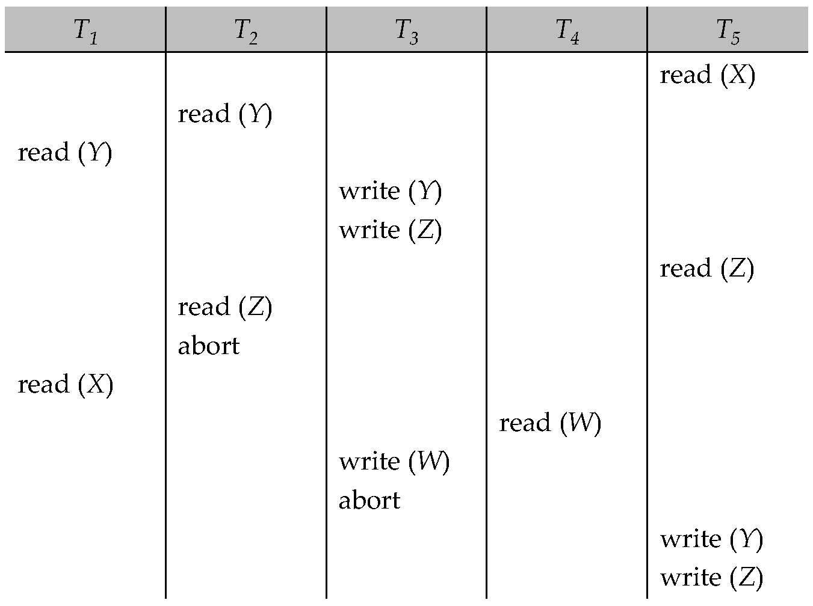
Timestamp-Based Protocols (Cont.)
A partial schedule for several data items for transactions with
timestamps 1, 2, 3, 4, 5

Slide 37
Timestamp-Based Protocols (Cont.)
Suppose that transaction T_{i} issues write(Q).
If TS(T_{i}) < R-timestamp(Q), then the value of Q that T_{i} is producing was needed previously, and the system assumed that that value would never be produced.
Hence, the write operation is rejected, and T_{i} is rolled back.
If TS(T_{i}) < W-timestamp(Q), then T_{i} is attempting to write an obsolete value of Q.
Hence, this write operation is rejected, and T_{i} is rolled back.
Otherwise, the write operation is executed, and W-timestamp(Q) is set to TS(T_{i}).

Slide 38
Thomas’ Write Rule
Modified version of the timestamp-ordering protocol in which obsolete write operations may be ignored under certain circumstances.
When T_{i} attempts to write data item Q, if TS(T_{i}) < W-timestamp(Q), then T_{i} is attempting to write an obsolete value of {Q}.
Rather than rolling back T_{i} as the timestamp ordering protocol would have done, this {write} operation can be ignored.
Otherwise this protocol is the same as the timestamp ordering protocol.
Thomas' Write Rule allows greater potential concurrency.
Allows some view-serializable schedules that are not conflict-serializable.

Slide 39
Validation-Based Protocol (CO5)
Execution of transaction T_{i} is done in three phases.
1. Read and execution phase: Transaction T_{i} writes only to
temporary local variables
2. Validation phase: Transaction T_{i} performs a ``validation test''
to determine if local variables can be written without violating serializability.
3. Write phase: If T_{i} is validated, the updates are applied to the
database; otherwise, T_{i} is rolled back.
The three phases of concurrently executing transactions can be interleaved, but each transaction must go through the three phases in that order.
Assume for simplicity that the validation and write phase occur together, atomically and serially
Also called as optimistic concurrency control since transaction executes fully in the hope that all will go well during validation

Slide 40
Validation-Based Protocol (Cont.)
Each transaction T_{i} has 3 timestamps
Start(T_{i}) : the time when T_{i} started its execution
Validation(T_{i}): the time when T_{i} entered its validation phase
Finish(T_{i}) : the time when T_{i} finished its write phase
Serializability order is determined by timestamp given at validation time, to increase concurrency.
Thus TS(T_{i}) is given the value of Validation(T_{i}).
This protocol is useful and gives greater degree of concurrency if probability of conflicts is low.
because the serializability order is not pre-decided, and
relatively few transactions will have to be rolled back.

Slide 41
Validation Test for Transaction T_{j} (CO 5)
If for all T_{i} with TS (T_{i}) < TS (T_{j}) either one of the following condition holds:
finish(T_{i}) < start(T_{j})
start(T_{j}) < finish(T_{i}) < validation(T_{j}) and the set of data items written by T_{i} does not intersect with the set of data items read by T_{j}.
then validation succeeds and T_{j} can be committed. Otherwise, validation fails and T_{j} is aborted.
Justification: Either the first condition is satisfied, and there is no overlapped execution, or the second condition is satisfied and
the writes of T_{j} do not affect reads of T_{i} since they occur after T_{i} has finished its reads.
the writes of T_{i} do not affect reads of T_{j} since T_{j} does not read any item written by T_{i}.

Slide 42
Multiple Granularity (CO 5)
Allow data items to be of various sizes and define a hierarchy of data granularities, where the small granularities are nested within larger ones
Can be represented graphically as a tree (but don't confuse with tree-locking protocol)
When a transaction locks a node in the tree explicitly, it implicitly locks all the node's descendents in the same mode.
Granularity of locking (level in tree where locking is done):
fine granularity (lower in tree): high concurrency, high locking overhead
coarse granularity (higher in tree): low locking overhead, low concurrency

Slide 43
Multiple Granularity (CO 5)
it can be defined as hierarchically breaking up the database into blocks which can be locked.
The Multiple Granularity protocol enhances concurrency and reduces lock overhead.
It maintains the track of what to lock and how to lock.
It makes easy to decide either to lock a data item or to unlock a data item. This type of hierarchy can be graphically represented as a tree.

Slide 45
Intention Lock Modes (CO 5)
In addition to S and X lock modes, there are three additional lock modes with multiple granularity:
intention-shared (IS): indicates explicit locking at a lower level of the tree but only with shared locks.
intention-exclusive (IX): indicates explicit locking at a lower level with exclusive or shared locks
shared and intention-exclusive (SIX): the subtree rooted by that node is locked explicitly in shared mode and explicit locking is being done at a lower level with exclusive-mode locks.
intention locks allow a higher level node to be locked in S or X mode without having to check all descendent nodes.

Slide 46
Compatibility Matrix with Intention Lock Modes (CO 5)
The compatibility matrix for all lock modes is:
IS
IX
S
S IX
X
IS
✓
✓
✓
✓
×
IX
✓
✓
×
×
×
S
✓
×
✓
×
×
S IX
✓
×
×
×
×
X
×
×
×
×
×

Slide 47
Multiple Granularity Locking Scheme (CO 5)
Transaction T_{i} can lock a node Q, using the following rules:
The lock compatibility matrix must be observed.
The root of the tree must be locked first, and may be locked in any mode.
A node Q can be locked by T_{i} in S or IS mode only if the parent of Q is currently locked by T_{i} in either IX or IS mode.
A node Q can be locked by T_{i} in X, SIX, or IX mode only if the parent of Q is currently locked by T_{i} in either IX or SIX mode.
T_{i} can lock a node only if it has not previously unlocked any node (that is, T_{i} is two-phase).
T_{i} can unlock a node Q only if none of the children of Q are currently locked by T_{i}.
Observe that locks are acquired in root-to-leaf order, whereas they are released in leaf-to-root order.

Slide 48
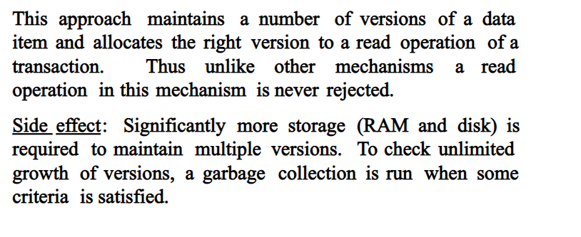
Multi version Concurrency Control Technique (CO 5)

Slide 49
Multi version Concurrency Control Technique (CO 5)
Multiversion schemes keep old versions of data item to increase concurrency.
Multiversion Timestamp Ordering
Multiversion Two-Phase Locking
Snapshot isolation
Each successful write results in the creation of a new version of the data item written.
Use timestamps to label versions.
When a read(Q) operation is issued, select an appropriate version of Q based on the timestamp of the transaction, and return the value of the selected version.
reads never have to wait as an appropriate version is returned immediately.

Slide 50
Multi version Concurrency Control Technique (CO 5)
MVCC: Implementation Issues
Creation of multiple versions increases storage overhead
Extra tuples
Extra space in each tuple for storing version information
Versions can, however, be garbage collected
E.g. if Q has two versions Q5 and Q9, and the oldest active transaction has timestamp > 9, than Q5 will never be required again

Slide 51
Multi version Concurrency Control Technique (CO 5)
MVCC: Implementation Issues
Creation of multiple versions increases storage overhead
Extra tuples
Extra space in each tuple for storing version information
Versions can, however, be garbage collected
E.g. if Q has two versions Q5 and Q9, and the oldest active transaction has timestamp > 9, than Q5 will never be required again

Slide 52
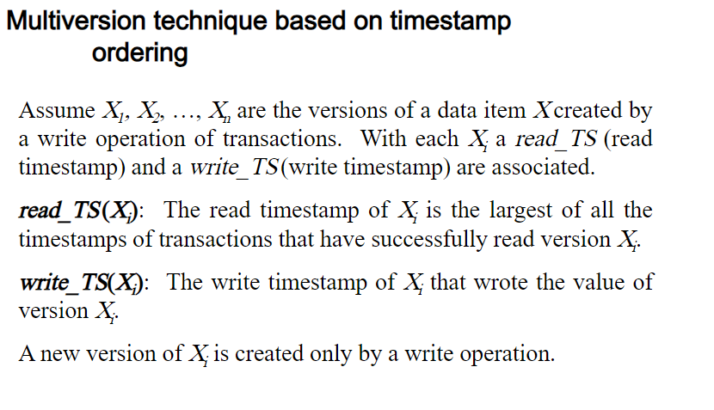
Multi version Concurrency Control Technique (CO 5)

Slide 53
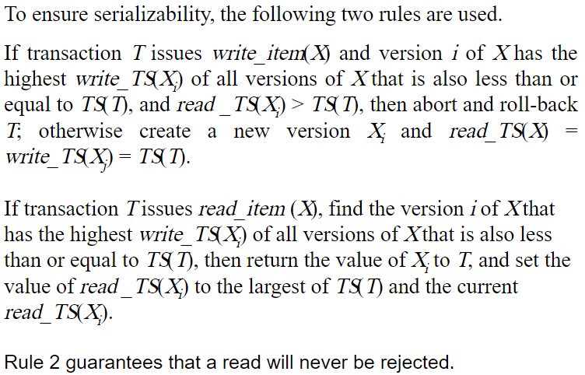
Multi version Concurrency Control Scheme (CO 5)

Slide 54
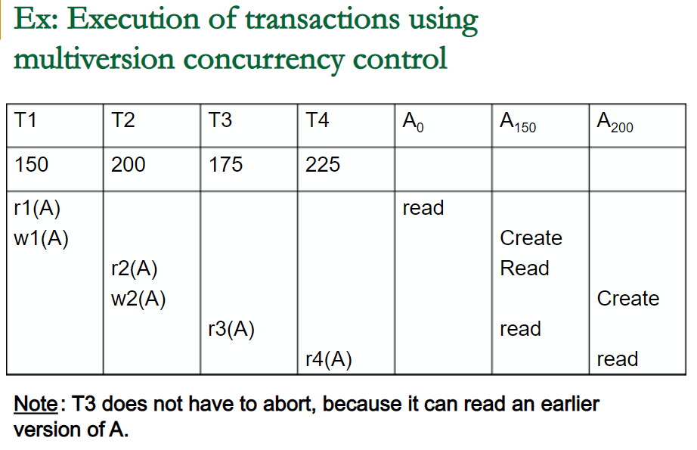
Multi version Concurrency Control Scheme (CO 5)

Slide 55
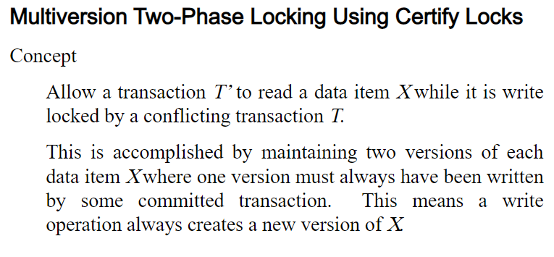
Multi version Concurrency Control Scheme (CO 5)

Slide 56
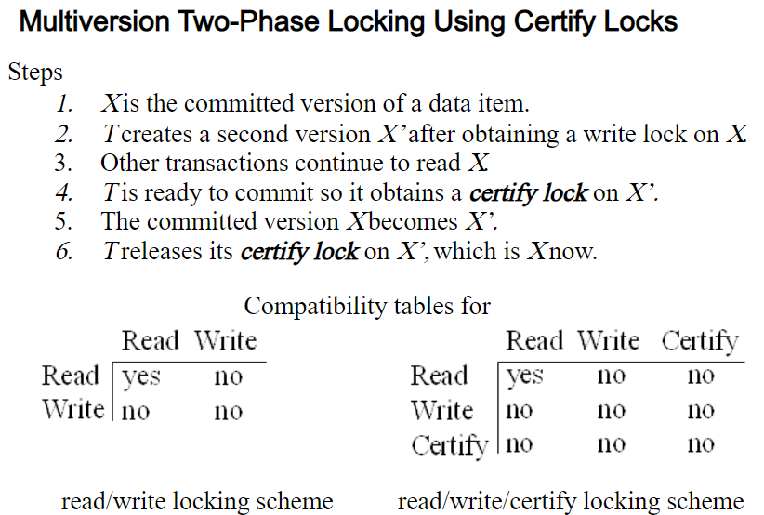
Multi version Concurrency Control Scheme (CO 5)

Slide 57
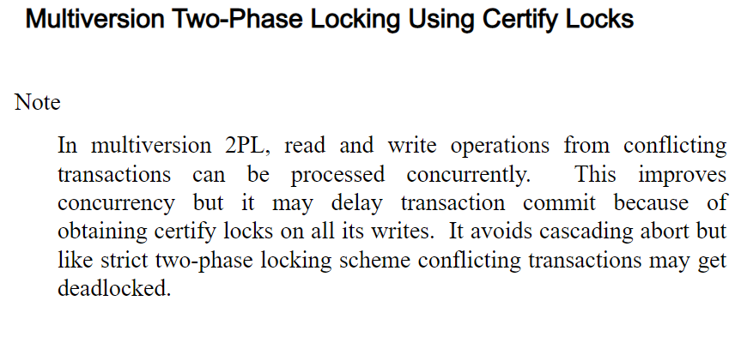
Multi version Concurrency Control Scheme (CO 5)

Slide 58
Phantom Problem
Insertions, deletions and updates can lead to the phantom phenomenon.
A transaction that scans a relation
(e.g., find sum of balances of all accounts in Perryridge)
and a transaction that inserts a tuple in the relation
(e.g., insert a new account at Perryridge)
(conceptually) conflict in spite of not accessing any tuple in common.
If only tuple locks are used, non-serializable schedules can result
E.g. the scan transaction does not see the new account, but reads some other tuple written by the update transaction
Index locking protocols used to prevent phantom phenomenon (see book for details)

Slide 59
Faculty Video Links, Youtube & NPTEL Video Links and Online Courses Details
Self Made Video Link:
Youtube/other Video Links
https://www.youtube.com/watch?v=Y4Rpi68sbus&list=PLyvBGMFYV3auVdxQ1-88ivNFpmUEy-U3M&index=32
https://www.youtube.com/watch?v=h2EfRyM_jUc&list=PLyvBGMFYV3auVdxQ1-88ivNFpmUEy-U3M&index=33
https://www.youtube.com/watch?v=ESsb6gqoIdc
https://www.youtube.com/watch?v=uQrJbA9_WNU
http://www.infocobuild.com/education/audio-video-courses/computer-science/FundamentalsOfDatabaseSystems-IIT-Kanpur/lecture-42.html
https://www.youtube.com/watch?v=jm1NUBMpyVo
https://www.youtube.com/watch?v=k0Tuf2weFyA
https://www.youtube.com/watch?v=QH4CF3OOmpM&list=PLyvBGMFYV3auVdxQ1-88ivNFpmUEy-U3M&index=36
https://www.youtube.com/watch?v=ls3gGWg8W4E

Slide 60
Daily Quiz
Explain concurrency.
What is two phase locking protocol?
What do you understand by a time stamp?
What is crash recovery?
Explain volatile and non volatile storage.
What are the reasons of transaction failure?
What are concurrent transactions?
Explain locking protocol for concurrency.

Slide 61
Weekly Assignment
Discuss the concurrency control mechanism in detail using suitable example. CO4
Differentiate between Two phase locking and Rigorous two-phase locking. CO4
How does the Timestamp Ordering protocol work? Explain with an example. CO4
What do you understand by multiple granularity? CO4
What is a system log? What is the purpose of the system log in system recovery? CO4

Slide 62
MCQ s
A transaction can proceed only after the concurrency control manager ________ the lock to the transaction a) Grants b) Requests c) Allocates d) None of the mentioned
The two phase locking protocol consists which of the following phases? a) Growing phase b) Shrinking phase c) More than one of the mentioned d) None of the mentioned

Slide 63
MCQ s
If a transaction can be granted a lock on an item immediately in spite of the presence of another mode, then the two modes are said to be ________ a) Concurrent b) Equivalent c) Compatible d) Executable
If a transaction may release locks but may not obtain any locks, it is said to be in ______ phase a) Growing phase b) Shrinking phase c) Deadlock phase d) Starved phase

Slide 64
Old Question Papers
http://www.aktuonline.com/papers/btech-cs-5-sem-data-base-management-system-KCS501-2020.pdf
http://www.aktuonline.com/papers/btech-cs-5-sem-database-management-system-KCS-501-2018-19.pdf
http://www.aktuonline.com/papers/btech-cs-5-sem-database-management-system-ncs-502-2017-18.pdf
http://www.aktuonline.com/papers/btech-cs-5-sem-database-management-system-ncs-502-2016-17.pdf

Slide 65
Expected Questions for University Exam
Define Concurrency Control.
Explain Concurrency Control. Why it is needed in database system?
What is log file? Write the steps for log based recovery of a system with suitable example.
What do you mean by multi granularity? How the concurrency is maintained in this case.
What are multi version schemes of concurrency control? Describe with the help of an example. Discuss the various Time stamping protocols for concurrency control also.

Slide 66
Summary
Knowledge of concurrency control techniques
Locking protocols
Time stamp based protocols
Validation based protocols
Knowledge of recovery with concurrent transactions.

Slide 67
MCQ
1.State whether the following statements are true or false. Justify. No Justification, no marks.
1. Level 1 transaction is the minimum consistency requirement that allows a transaction to be recovered in the event of system failure.
2. There is no deadlock in the timestamp method of concurrency control.
3. Level 0 transactions are recoverable.
4. The objective of concurrency control is to schedule or arrange the transactions in such a way as to avoid any interference.
5. In a shrinking phase, a transaction release all locks and can not obtain any new locks.

Slide 68
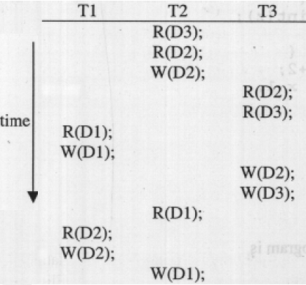
MCQ (CO5)
2. Consider three data items D1, D2 and D3 and the following execution schedule of transactions T1, T2 and T3. In the diagram, R(D) and W(D) denote the actions reading and writing the data item D respectively.
Which of the following statements is correct? (A) The schedule is serializable as T2; T3; T1 (B) The schedule is serializable as T2; T1; T3 (C) The schedule is serializable as T3; T2; T1 (D) The schedule is not serializable

Slide 69
MCQ (CO5)
3. Which of the following scenarios may lead to an irrecoverable error in a database system ?
a. A transaction writes a data item after it is read by an uncommitted transaction
b. A transaction reads a data item after it is read by an uncommitted transaction
c. A transaction reads a data item after it is written by a committed transaction
d. A transaction reads a data item after it is written by an uncommitted transaction
4. The deadlock state can be changed back to stable state by using __statement.
a) Commit b) Rollback c) Savepoint d) Deadlock
5. What are the ways of dealing with deadlock? a) Deadlock prevention b) Deadlock recovery c) Deadlock detection d) All of the mentioned

Slide 70
Weekly Assignment 5 (CO5)
Explain the Following Questions.
What is Concurrency Control? Why it is needed ? What is its importance?
Explain different problem of Concurrency control with and example?
What is locking? What are the Different types of Lock? Explain different level of locking?
How does Locking Protocol work?
What are the disadvantage of Basic locking protocal? What is Advantage of two phase locking?
How does 2PL work?
What is Timestamp Ordering protocol?
How does Timestamp Ordering protocol work? Explain with an example?
What is Thomas’s write rule and why is it important
What are the different phases in a validation based concurrency technique?
How does validation based concurrency technique work?

Slide 71
Glossary Questions
Fill in the blanks using given Glossary
Keywords: Intention lock modes, W-timestamp(Q), Timestamp-ordering protocol, Validation protocol, Checkpoint facility, Deferred-modification
____________ denotes the largest timestamp of any transaction that executed write(Q) successfully.
If a node is locked in __________ explicit locking is being done at a lower level of the tree, but with only shared-mode locks.
The _____________ ensures that any conflicting read and write operations are executed in timestamp order.
If a transaction does not modify the database until it has committed, it is said to use the ___________ technique.
DBMS periodically suspends all processing and synchronizes its files and journals through the use of_________________
The __________ requires that each transaction Ti executes in two or three different phases in its lifetime, depending on whether it is a read-only or an update transaction.

Slide 72
Old Question Papers
https://drive.google.com/drive/u/0/folders/1gWUEwo7Ztpxs4smy34fl9jWQrx4AKpkC

Slide 73
Old Question Papers
http://www.aktuonline.com/papers/btech-cs-5-sem-data-base-management-system-KCS501-2020.pdf
http://www.aktuonline.com/papers/btech-cs-5-sem-database-management-system-rcs-501-2018-19.pdf
http://www.aktuonline.com/papers/btech-cs-5-sem-database-management-system-ncs-502-2017-18.pdf
http://www.aktuonline.com/papers/btech-cs-5-sem-database-management-system-ncs-502-2016-17.pdf

Slide 74
Expected Questions for University Exam
Explain the following protocol for concurrency Control
Time-stamp Protocol
Lock-Based Protocol
What is Two phase Locking (2PL)? Describe with the help of example.
Describe major problems associated with concurrent processing with examples. Explain the role of locks in avoiding these problems?
Discuss the locking mechanism in multiple granularity case.
What are multi version schemes of concurrency control? Describe with the help of an example. Discuss the various Time stamping protocols for concurrency control also.

Slide 75
References
Korth, Silbertz, Sudarshan,” Database Concepts”, McGraw Hill
Date C J, “An Introduction to Database Systems”, Addision Wesley
Elmasri, Navathe, “ Fundamentals of Database Systems”, Addision Wesley
Thank You

